Slide 1
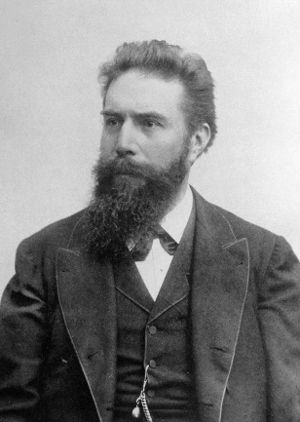
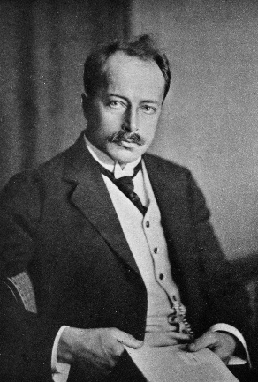
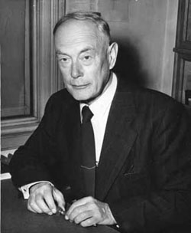
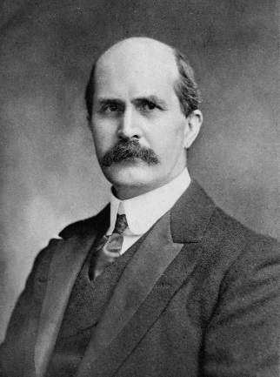
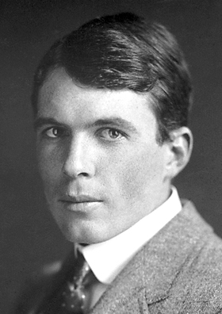
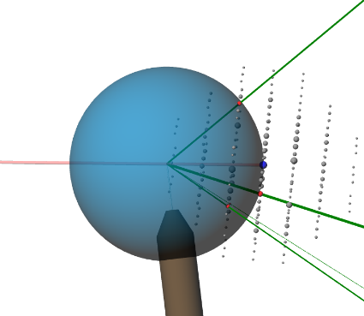
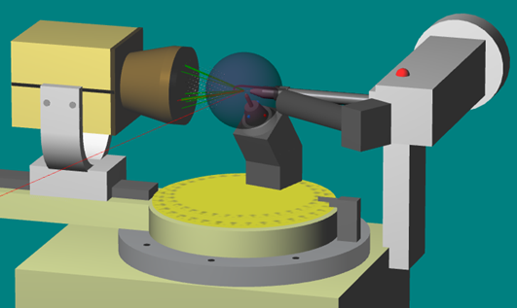
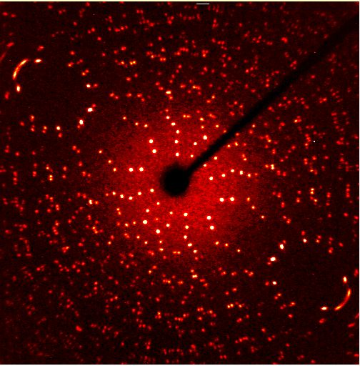
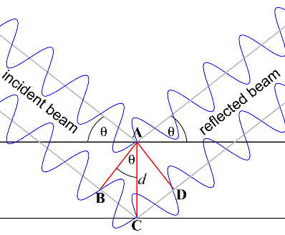
Bragg’s Law, the Reciprocal Lattice and the Ewald Sphere Construction

Slide 2
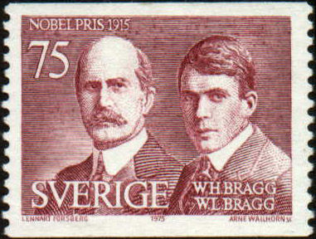
Bragg’s Law
$$nλ = 2d\sin{θ}$$
waves still in phase: constructive interference
two neighbouring layers of the crystal lattice

Slide 3
Construct a 2D “real space” lattice using these parameters
b
6 Å
110°
8 Å
a
origin
“real-space” lattice points
Scale: 1 cm = 1 Å
Notes:
For this construction you need the following: pencil, eraser, ruler, protractor and an A3 sheet of paper (American equivalent: Tabloid or Ledger, measuring 11 x 17″). Draw the “real space” lattice as follows:
Place the origin of the “real space” lattice in the centre of the page (use a point).
Draw a horizontal line through the origin and mark points at -8 and 8 cm from the origin
Draw three oblique lines at an angle of 110° to the horizontal line, and passing through the three points.
On each oblique line, mark points at distances of 6 and -6 cm from the horizontal line.
Complete the diagram as shown

Slide 4
Populate the reciprocal lattice with -2 ≤ h ≤ 2 and -2 ≤ k ≤ 2
24 points:
-2 -2 | -2 -1 | -2 0 | -2 1 | -2 2
-1 -2 | -1 -1 | -1 0 | -1 1 | -1 2
0 -2 | 0 -1 | - | 0 1 | 0 2
1 -2 | 1 -1 | 1 0 | 1 1 | 1 2
2 -2 | 2 -1 | 2 0 | 2 1 | 2 2
Notes:
We will populate the diagram with 24 reciprocal lattice (R.L.) points corresponding to -2 ≤ h ≤ 2 and -2 ≤ k ≤ 2. The R.L. will share its origin with the “real space” lattice.
This will be a tedious process, but it designed to be tedious to cement the concepts.
Proceed in the order h k = 1 1, 0 1, -1 1, -1 0. For each of these points, determining the position of -h –k is trivial
Proceed to the next shell: 2 2, 1 2, 0 2, …

Slide 5
Construct a 2D Reciprocal Lattice
hk = 11
d₁₁ = 3.91Å
Notes:
Consider the R.L. point for the (1 1) Miller lines:
Draw the (1 1) lines (very lightly, because you will want to erase them later)
Measure the shortest distance between adjacent lines: approximately 3.91 cm, corresponding to d₁₁ = 3.91 Å
Starting at the origin, draw a line perpendicular to the (1 1) line passing through the origin
The 1 1 R.L. point will be placed on this vector (see next few slides)

Slide 6
Formula for calculating d_{hk}
$$\frac{1}{d_{hk}^{2}}= \frac{h^{2}}{a^{2}\sin^{2}γ} + \frac{k^{2}}{b^{2}\sin^{2}γ} − \frac{2hk\cos{ γ}}{ab \sin^{2}γ}$$
Use the Excel spreadsheet provided
Notes:
Fortunately it is not necessary to measure d_{hk} in each case because it can be calculated quite easily. The formula for determining d_{hk} from the 2D “real space” lattice parameters a, b and γ is shown. For convenience, this formula is implemented in an Excel spreadsheet (provided)

Slide 7
Draw the R.L. point corresponding to (1 1)
hk = 11
11
*
d₁₁ = 3.91Å
in reciprocal space, use: 1 cm = 0.04 Å⁻¹
... so plot the R.L. point 6.39 cm (i.e. 1/d × 25 cm) from the origin
Notes:
We need to use an appropriate scale for reciprocal space such that our R.L. points will be on the same page. It is convenient to use 1 cm = 0.04 Å^{-1.}. This scale is implemented in the Excel spreadsheet.
If d₁₁ = 3.91 Å then, according to the spreadsheet, the R.L. point should be drawn at a distance of 6.39 cm from the origin, and in the direction of positive h and positive k (i.e. according to the signs of h and k).

Slide 8
Draw the R.L. point corresponding to (-1 -1)
hk = -1-1
11
*
d₁₁ = 3.91Å
-1-1
*
Notes:
The R.L. point corresponding to Miller line (-1 -1) (i.e. Friedel relationship) can be placed at the same distance from the origin, but in the opposite direction. This means that we only need to carry out the d_{hk} calculations for half the points.

Slide 9
Populate the R.L. for -2 ≤ h ≤ 2 and -2 ≤ k ≤ 2
22
12
*
02
*
-12
*
-22
*
*
21
11
*
01
*
-11
b
*
-21
*
*
20
10
*
*
-10
-20
*
a
*
2-1
1-1
*
0-1
*
-1-1
*
-2-1
*
*
2-2
1-2
*
0-2
*
-1-2
*
-2-2
*
*
Notes:
Complete the R.L for the 24 points with -2 ≤ h ≤ 2 and -2 ≤ k ≤ 2.
We notice that the R.L. is also a lattice, as the name suggests

Slide 10
The R.L. can be defined by its own unit cell
22
12
*
02
*
-12
*
-22
*
*
21
11
*
01
*
-11
b
*
-21
*
*
20
10
*
*
-10
-20
*
a
*
2-1
1-1
*
0-1
*
-1-1
*
-2-1
*
*
2-2
1-2
*
0-2
*
-1-2
*
-2-2
*
*
Notes:
The R.L. can also be assigned a unit cell, as defined by the points 0 0, 1 0, 1 1 and 0 1.

Slide 11
The R.L. can be defined by its own unit cell
11
01
*
b
*
b*
γ*
10
a*
*
0
a
Notes:
The parameters of the reciprocal cell are given as a*, b* and γ*. Note the inverted relationships between a and a*, and b and b*. We also note that γ* = 180 - γ.

Slide 12
Take-home Messages
The reciprocal lattice is a regular lattice too
hk in opposite direction to –h – k
Each R.L. point hk is drawn on a line ⊥ to the (hk) real-space line (plane in 3D), and at a distance of 1/d_{hk} from the origin
There is a distinct geometrical relationship between the R.L. and the real-space lattice
The scale at which the R.L. is drawn is arbitrary
Notes:
The exercise of drawing a 2D R.L. is designed to be tedious so that the important take-home messages can be absorbed.

Slide 13
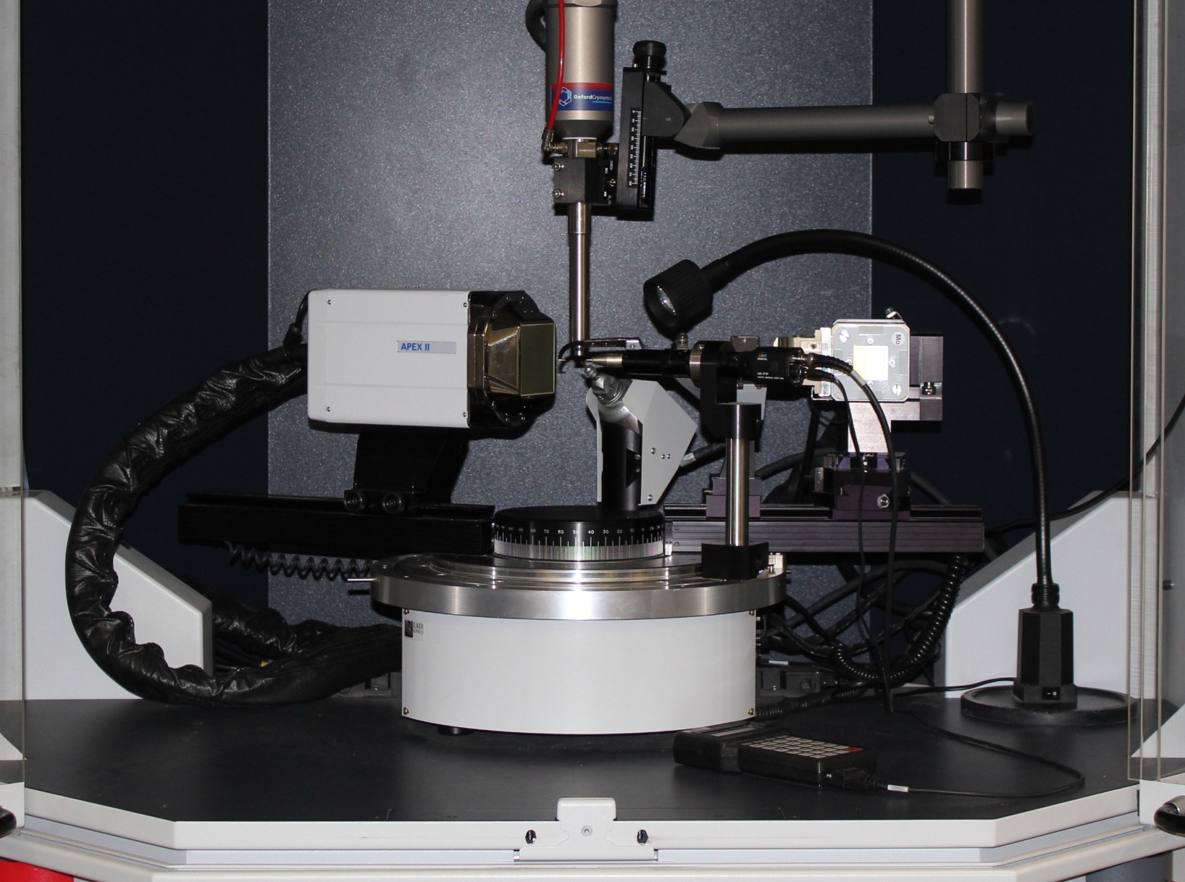
Diffraction Geometry and the Ewald Sphere
Notes:
By understanding the Ewald sphere construction, you will be able to visualise how the data collection experiment gives rise to diffraction spots on the computer screen.

Slide 14
The Ewald sphere construction is key to understanding diffraction geometry
diffracted beam
reciprocal lattice
incident X-ray beam
crystal
Paul Ewald, 1888-1985

Slide 15
A 2D analogy – the Ewald Circle
1/λ
area
detector
Notes:
Real and reciprocal space are superimposed in this construction. The reciprocal space scale is arbitrary, but must be the same for all of the objects in reciprocal space. We begin by drawing a circle (in reciprocal space) of radius 1/λ, with the crystal (in real space) at its centre.

Slide 16
X-ray beam
beam stop
Notes:
The X-ray beam passes through the centre of the circle

Slide 17
Notes:
We place the reciprocal lattice with its origin at the point where the X-ray beam exits the circle. The orientation of the R.L. corresponds to the orientation of the crystal – if we rotate the crystal, then the R.L. is rotated by the same amount.
Animation 1: we shift the R.L. such that its origin is at the point where the beam exits the circle.

Slide 18
R.L. origin
1 4
a*
b*
Notes:
Consider R.L. point 1 4, shown in red. If we rotate the crystal clockwise by approximately 7°, the R.L. will track this rotation such that this point will touch the circle.

Slide 19
1 4
Notes:
R.L. point 1 4 is on the circle

Slide 20
B
1 4
B
1/d₁₄
θ
A
2/λ
C
Notes:
From the way in which we construct the R.L. from the real-space lattice, we know that line BC = 1/d₁₄, and also that BC is perpendicular to the set of Miller lines (1 4). We also know that triangle ABC is a right-angle triangle. Therefore, AB is parallel to the (1 4) Miller lines. We let θ be the angle ∠CAB.
Since ABC is a right-angle triangle, sin θ = BC/AC = 1/d₁₄ ÷ 2/λ, which can be rearranged to , λ = 2d₁₄ × sin θ

Slide 21
1 4
1/d₁₄
θ
θ
θ
2/λ
Notes:
Since the Bragg equation is satisfied when a R.L. point touches the circle, the corresponding set of lines (planes in 3D) will give rise to a diffracted beam, which can be recorded by the detector. We can see the Bragg construction at the centre of the circle.
The implication of this Ewald construction is that we can record the R.L. by sweeping it through the circle, which can be accomplished by rotating the crystal.

Slide 22
1 4
1 2
2/λ
-1 -1
Notes:
We can see that, in this particular orientation of the crystal, two other R.L. points are in positions that satisfy their conditions for the Bragg equation

Slide 23
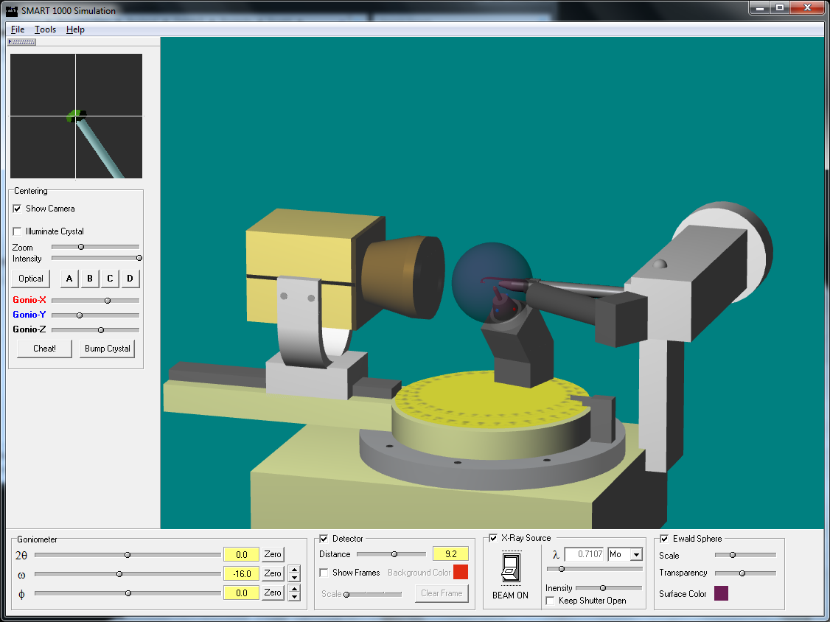
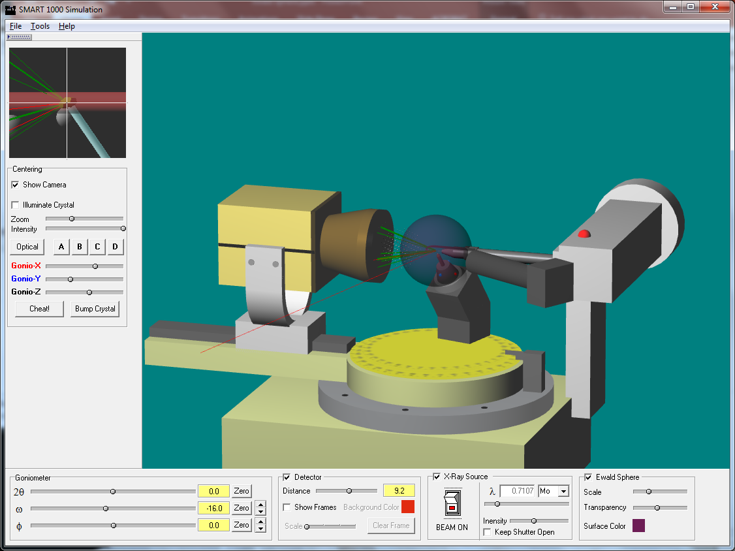
Diffraction Geometry and the Ewald Sphere
Notes:
Since the single-crystal diffraction experiment involves recording a 3D reciprocal lattice by sweeping it through the Ewald sphere, the concept is difficult to illustrate using a 2D medium. The program Ewald was devised to illustrate the 3D Ewald sphere construction interactively by it on a simulation of a diffractometer.

